Slide 1

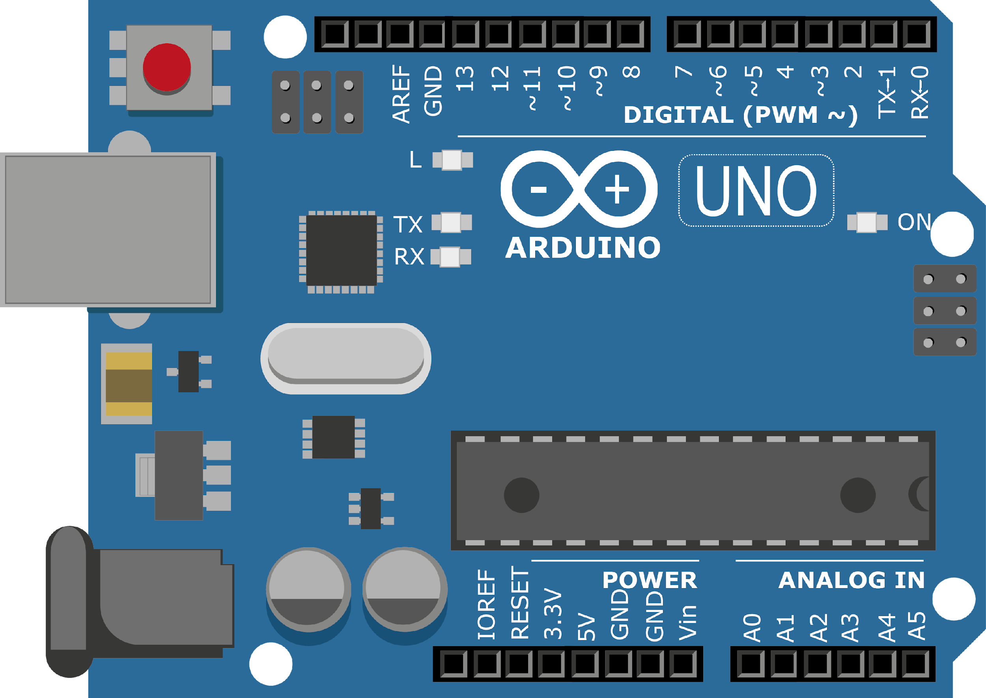
ARDUINO MASTER CLASS
10
TFT Display with Arduino

Slide 2
10 AGENDA
02
03
01
Interface Display
TFT Display
Q & A

Slide 3
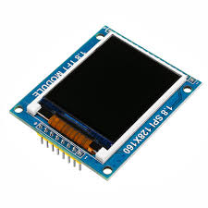
TFT Display
A TFT display on a computer monitor is brighter and faster than a regular LCD display. TFT stands for "thin-film transistor." LCD stands for "liquid crystal display." Both terms refer to the flat-panel display, or screen, of a computer monitor or television set.

Slide 4
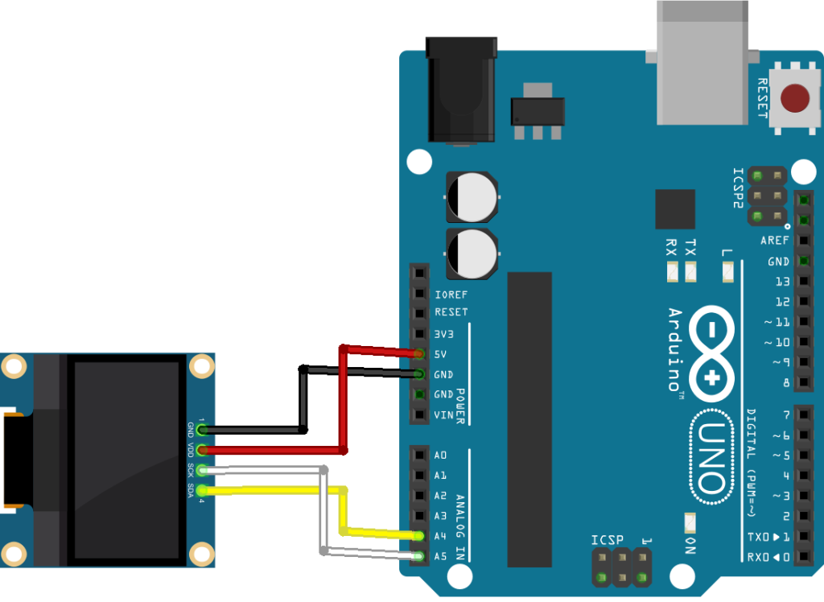
Display with Arduino

Slide 5

INTERVIEW QUESTIONS
what are buses used for communication in embedded system?
Watchdog Timer
microcontroller is 8-bit then here 8-bit ?
I2C-communication between multiple ICs
CAN-automobiles with centrally controlled network
USB-communication between CPU and devices like mouse, etc.
ISA, EISA, PCI - standard buses for parallel communication used in PCs, computer network devices, etc.
it means that it is capable of processing 8-bit data at a time. Data processing is the task of ALU and if ALU is able to process 8-bit data then the data bus should be 8-bit wide. I
A watchdog timer is an electronic device or electronic card that execute specific operation after certain time period if something goes wrong with an electronic system.

Slide 6

THANKS!

